Slide 1
Software Engineering
Week 10 Lecture 01

Slide 2
CODING STYLES
The coding is the process of transforming the design of a system into a computer language format.
In software development, coding phase is the conversion of gathered requirements into realization.

Slide 3
Goal of Coding
The goal is not to reduce the effort and cost of the coding phase, but to cut to the cost of a later stage.
The cost of testing and maintenance can be significantly reduced with efficient coding.

Slide 4


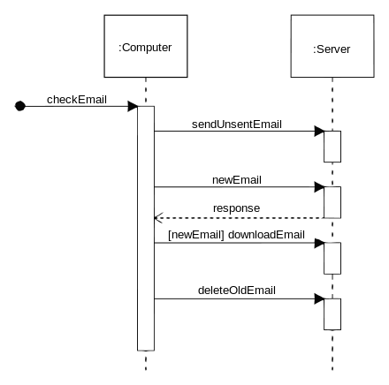
Goal of Coding [contd..]
1- To translate the design of system into a computer language format:

Slide 5
Goal of Coding [contd..]
2- To reduce the cost of later phases:
Reduce the cost of testing and maintenance.
Example:

Slide 6
Goal of Coding [contd..]
int main() {
int num;
cout << "Enter a number: ";
cin >> num;
// Check if the number is prime
bool isPrime = true;
for (int i = 2; i < num; i++) {
if (num % i == 0) {
isPrime = false;
break;
}
}
// Display the result
if (isPrime) {
cout << num << " is a prime number." << endl;
} else {
cout << num << " is not a prime number." << endl;
}
return 0;
}

Slide 7
Goal of Coding [contd..]
Issues with the code:
Single function: As the code grows, it will become difficult to manage and maintain all the logic.
No error handling: Code doesn’t handle invalid input scenarios, e.g., if user enters non-numeric values.

Slide 8
Goal of Coding [contd..]
bool isPrime(int num) {
if (num <= 1) {
return false;
}
for (int i = 2; i * i <= num; i++) {
if (num % i == 0) {
return false;
}
}
return true;
}
int main() {
int num;
cout << "Enter a number: ";
cin >> num;
if (isPrime(num)) {
cout << num << " is a prime number." << endl;
} else {
cout << num << " is not a prime number." << endl;
}
return 0;
}
Notes:
if a number is not divisible by any smaller number up to its square root, it won't be divisible by larger numbers either.

Slide 9
Goal of Coding [contd..]
Improvements in the code:
Separate function: This modification makes the code more manageable and allows specific functionalities to be tested independently.
Error Handling: The code checks that the user provides a positive number before performing the prime number check.

Slide 10
Goal of Coding [contd..]
3- Making the program more readable: a clear coding activity can itself help in producing more maintainable software.
Example:

Slide 11
Goal of Coding [contd..]
#include<iostream>
using namespace std; int main(){int a=10;int b=5;int s=a+b;cout<<“The sum is:"<<s<<endl;return 0;}
#include <iostream>
using namespace std;
int main() {
int num1 = 10;
int num2 = 5;
int sum = num1 + num2;
cout << "The sum of " << num1 << " and " << num2 << " is: " << sum << endl;
return 0;
}

Slide 12
Characteristics of Programming Language
Readability: Allow programs to be written in way that are self descriptive (in English language)
Portability: Allow code to run on different platforms without significant changes.
Error checking: Invoke error handling to check and handle runtime errors and exceptions.

Slide 13
Characteristics of Programming Language [contd..]
Modularity: Allow breaking down code into reusable modules or functions, enabling organization and code reuse.
Abstraction: Provide mechanisms hiding complex implementation details and simplify programming tasks.
Efficiency: Authorize the creation of an efficient object code.

Slide 14
Characteristics of Programming Language [contd..]
Characteristic | Programming Language with Characteristic | Programming Language without Characteristic
Readability | Python | Perl
Portability | Java | Assembly
Error Checking | Rust | C
Modularity | JavaScript | Bash
Abstraction | C# | Assembly
Efficiency | C/C++ | Python

Slide 15
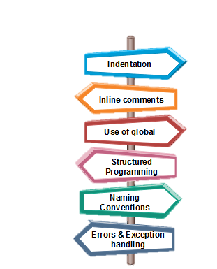
Coding Standards
General coding standards refers to how the developer writes code, so here we will discuss some essential standards regardless of the programming language being used.

Slide 16
Coding Standards [contd..]
Indentation: (the practice of adding spaces or tabs at the beginning of a line of code to visually represent the hierarchical structure)
To make program readable and maintainable, proper indentation in necessary.
Example:

Slide 17
Coding Standards [contd..]
Program without indentation | Program with indentation
#include<iostream> int main() {int num1=5; int num2=10; if(num1>num2){cout<<"num1 is greater than num2"<<endl;} else{cout<<"num2 is greater than num1"<<endl;} | #include <iostream> int main() { int num1 = 5; int num2 = 10; if (num1 > num2) { cout << "num1 is greater than num2" << endl; } else { cout << "num2 is greater than num1" <<endl; } }

Slide 18
Coding Standards [contd..]
Inline comments: To analyze the working of functions and highlight key aspects of code.
Don’t use GOTO statement: Difficult to follow and maintain code and lead to unstructured and spaghetti-like code.
Naming conventions: global variable names always begin with a capital letter, local variable names are made of small letters, and constant names are always capital letters.
Notes:
include if-else statements, loops (such as for, while), and switch statements.

Slide 19
Coding Standards [contd..]
Error return conventions and exception handling system: Code should contain error handling mechanisms.
Example: If a user doesn’t enter the data of required datatype, the program should through and exception instead of being closed altogether.

Slide 20
Exception Handling code
#include <stdexcept>
int main() {
try {
int num;
cout << "Enter an integer: ";
cin >> num;
if (cin.fail())
{
throw runtime_error("Invalid input. Expected an integer.");
}
// Rest of the code logic here...
cout << "Entered integer: " << num << endl;
}
catch (const exception& e) {
cout << "Exception occurred: " << e.what() << endl;
}
return 0;
}

Slide 21
Programming Style
Clarity and simplicity of Expression: The programs should be designed in such a manner so that the objectives of the program is clear.
Example: int result = a + b * c / d - e;
Modified code: int result = (a + b) * (c / d) - e;

Slide 22
Programming Style [contd..]
Naming: Names of module should be clear.
Example: a = 3.14 * r * r
Modified Example: area of circle = 3.14*radius*radius;
Information hiding: The information secure in the data structures should be hidden from the rest of the system where possible.

Slide 23
Programming Style [contd..]
Nesting: Deep nesting of loops and conditions greatly harm the static and dynamic behavior of a program
User-defined types: Make heavy use of user-defined data types like enum, class, structure, and union.

